Slide 1
TIU Tracking System
Sponsor Intel
Advisor Prof. Robert Daasch
Team Daniel Ferguson
Man Hoang
Lynh Pham
Tri Truong
Dung Le

Slide 2
Introduction
Problem statement
Key requirements
Size
Power
Accuracy

Slide 3
Agenda
System Overview
Hardware
Firmware
Software
Deployment
Results
Conclusions

Slide 4




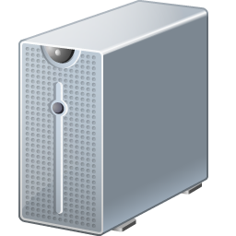





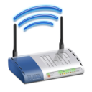
System Overview
Back-end
Front-end
Users
Web App
Database
Tag
Admin
Controller
+
Location Engine(s)
Wi-Fi
Proxy
Detector

Slide 5
Agenda
System Overview
Hardware
Firmware
Software
Deployment
Results
Conclusions

Slide 6
Hardware
Devices
Tag
Detector
Proxy
Components
RF12 transceiver
ATmega328p MCU
WiFly 802.11b/g transceiver
Schematic and layout by Eagle CAD
PCB by Sunstone Circuits

Slide 7
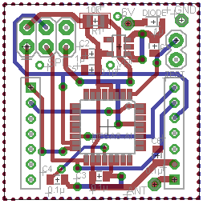
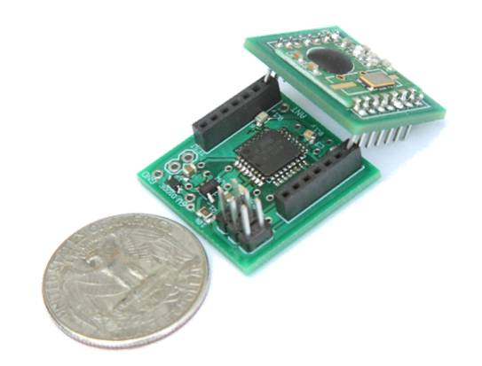
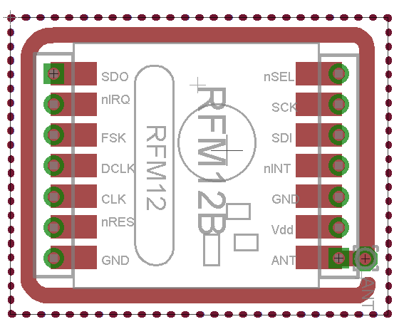
Hardware
Tag
RF12 transceiver
ATmega328p MCU
Size: 1” x 1” x 1”
240mAh coin cell battery
Main Board Layout
Product
Breakout Board Layout

Slide 8
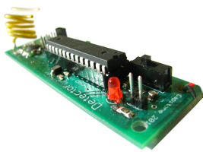
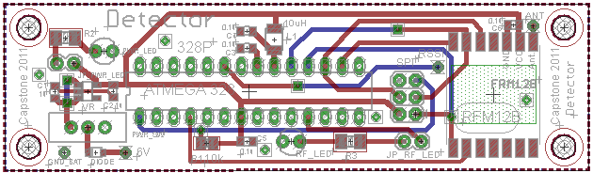
Hardware
Detector
RF12 transceiver
ATmega328p MCU
Status LED
Size: 3.5” x 1”
Product
Layout

Slide 9
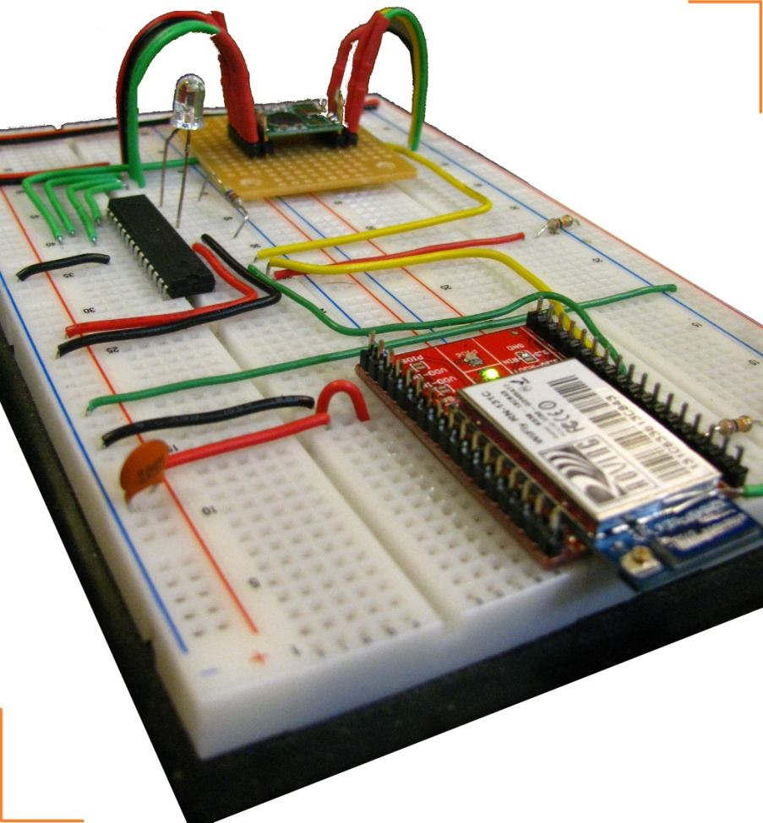
Hardware
Proxy
RF12 transceiver
ATmega328p MCU
WiFly 802.11b/g transceiver
Breadboard prototype
Ceramic antenna

Slide 10
Agenda
System Overview
Hardware
Firmware
Software
Deployment
Results
Conclusions

Slide 11
Firmware
Tag broadcasts
Detectors relay
Proxy forwards to Controller
Front-end
Tag
Proxy
Detector

Slide 12
Firmware
Tag
Mostly in low power state
Periodically wakes up to broadcast
Detector
Listen for messages from tags and other detectors
Controlled flooding
Collision avoidance via time division
Proxy
Listens for messages from detectors
Forwards messages to Controller
Generally
All speak a common message format which includes
Battery Information
Infrastructure for a more sophisticated routing protocol
Fixed length

Slide 13
Agenda
System Overview
Hardware
Firmware
Software
Deployment
Results
Conclusions

Slide 14
Software
Back-end
Web App
MySQL Database
Controller
+
Location Engine(s)
Proxy

Slide 15
Software
Controller
Collects data from Proxy
Feed data to Location Engine
Two operating modes
Calibrating
Collects RF signatures at calibration points
Stores calibration data in a local database
Locating
Passes calibration data to Location Engine
Collects and sorts data into packets
Feeds the packets to Location Engine
Stores results in MySQL Database

Slide 16
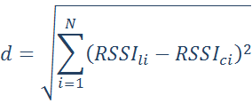
Software
Location Engine
Theory
Each location has a unique & consistent RSSI pattern
Euclidean distance
Reduce aliasing by
Referencing the nearest detector
Interpolating between two closest locations
RSSI Data
Input Filter
Fingerprint Matching Algorithm
Output Filter
Tag’s Location
Calibration Data

Slide 17
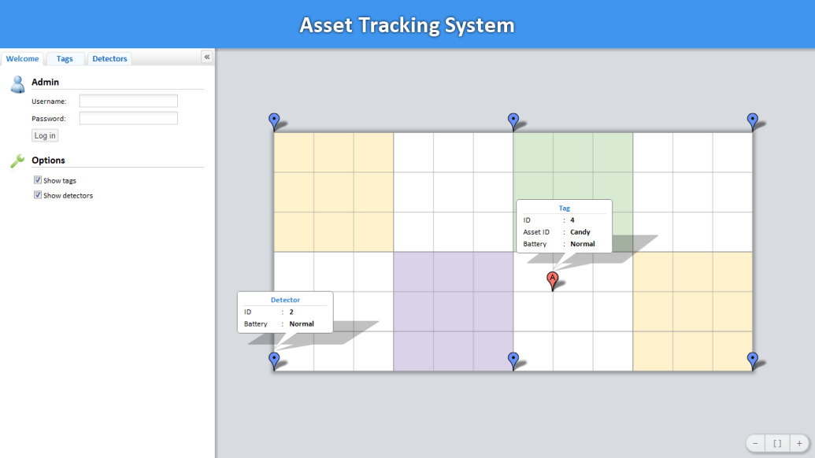
Software
Web App
Functionalities
Visualize tags’ and detectors’ locations
Add, modify, and remove tags and detectors
Configure the tracking area
Design Goals
Fast
Simple
Easy to use
Technologies
PHP
HTML5, CSS3, JavaScript
Why Web?
Notes:
So, why a Web app but not a traditional window application?
Well, unlike a traditional window application, which requires different versions for different platforms, a web app can have only one version, and it can run virtually everywhere, from a mobile phone to a desktop.
Also, it doesn’t require any additional user installation, so it’s always there, always ready for users to access.

Slide 18
Recap

Slide 19
Agenda
System Overview
Hardware
Firmware
Software
Deployment
Results
Conclusions

Slide 20
Deployment
Detector placement
Calibration density
Each tag has a unique ID with respect to other tags
Each detector has a unique ID with respect to other detectors
Proxy possible configurations
Proxy must have access to LAN
Proxy must create an Ad-Hoc Access point for Controller to connect to

Slide 21
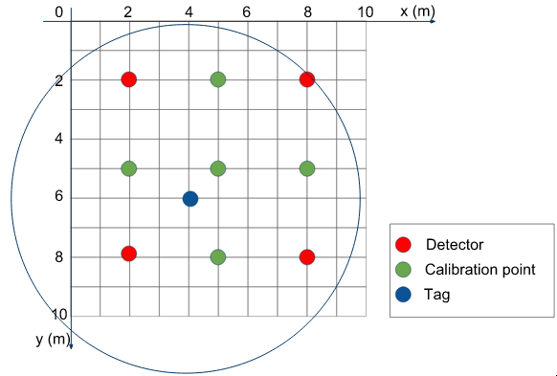
Deployment

Slide 22
Agenda
System Overview
Hardware
Firmware
Software
Deployment
Results
Conclusions

Slide 23
Results
Size: 1” x 1” x 1”

Slide 24



Results
Power
240mAh coin cell battery
30mA transmit current
40µA sleep current
1sec broadcast interval
3ms transmit window
0.3% duty cycle

Slide 25
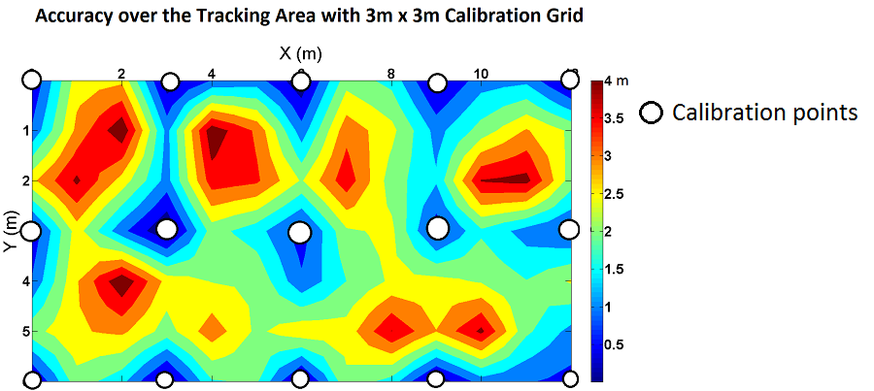
Results
Accuracy
Average 2m
Less than 1m at calibration points
Notes:
For accuracy, we conducted another experiment in a 12m x 6m area with a 3m calibration grid, and we found out that the average accuracy is roughly 2m.
The accuracy at calibration points is less than 1m for over 90% of the time. This indicates that if we calibrate the system at locations where the TIUs are usually placed, then probability of locating the TIUs accurately is very high.

Slide 26
Agenda
System Overview
Hardware
Firmware
Software
Deployment
Results
Conclusions

Slide 27
Conclusions
Antenna design
More testing
Calibration density
Detector placement
Improve testability
Different algorithms
Environment & signal strength

Slide 28
Acknowledgement
Professor Robert Daasch
Alfonso Pereira & Sameer Ruiwale

